Slide 1
Brownfields 101
Benefits of the Program
Rita Ware
214-665-6409
ware.rita@epa.gov

Slide 2


Brownfields 101
An introduction to Brownfields and understanding the benefits of the Brownfields Program for your community

Slide 3
Brownfields – The Beginnings
Brownfields were derived from the Superfund Law also officially known as the Comprehensive Environmental Response, Compensation, and Liability Act of 1980 (CERCLA)
CERCLA is designed to assess and clean-up sites that are potentially contaminated with hazardous substances.

Slide 4
Brownfields – The Beginnings
The Small Business and Liability Relief Brownfields Act is an amendment to CERCLA that allows:
  Grants to assess and cleanup sites
  Provides liability exemptions
Notes:
CERCLA had strict liability language which was often a deterrent to the redevelopment of brownfields sites. The Brownfields Act is an amendment to CERLCA to help alleviate liability issues.

Slide 5
CERCLA LIABILITY PROTECTIONS
State and Local Governmental Entity Acquisitions Exemptions 101(20)(D) and 101(35)(A)(ii)
BUILD Act changes:
Removed requirement that the government acquisition must be "involuntary."
There was previous confusion surrounding whether some acquisitions, such as planned "eminent domain," was an allowable method of acquisition.
However, this does not mean all "voluntary" acquisitions fall within this exemption.
For example, acquisition of a property for future private use, and acceptance of donated property, do NOT qualify under this exemption.

Slide 6
A Brownfield Is…
Real property, the expansion, redevelopment or reuse of a site may be complicated by the presence or potential presence of hazardous substance, pollutant, or contaminant.

Slide 7
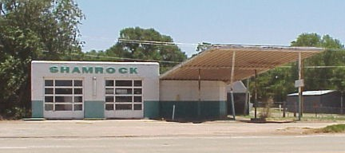
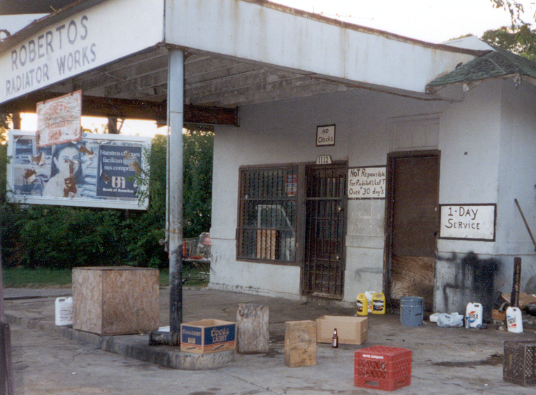
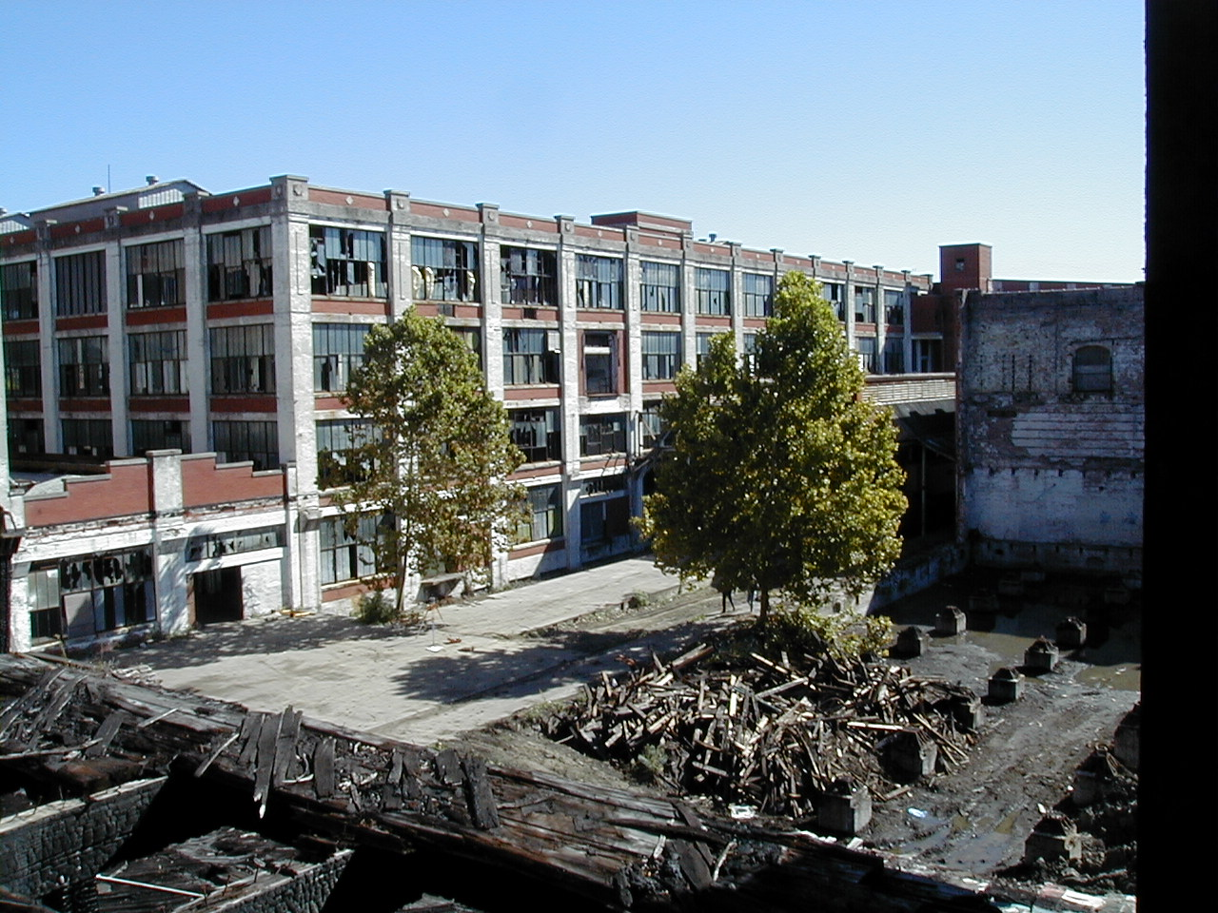
Examples of Brownfields
Notes:
Abandoned or dilapidated buildings like as a gas station, automotive shops are common brownfield sites
Look at these site…

Slide 8
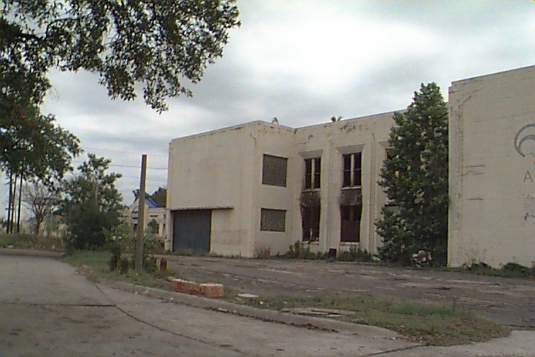
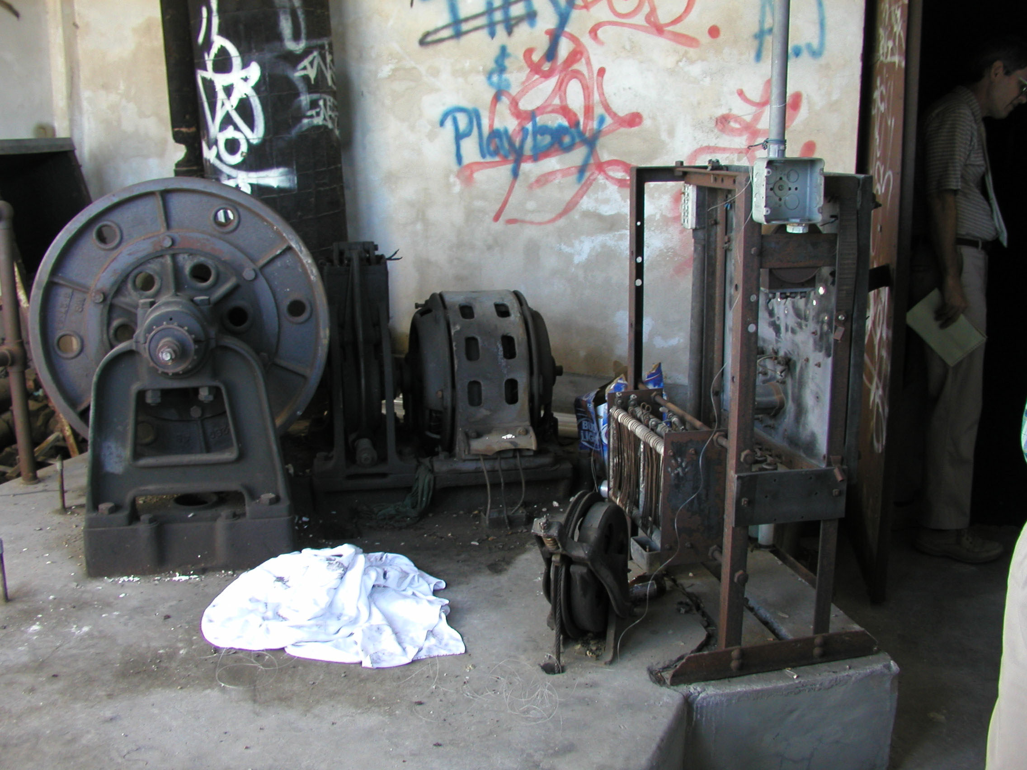
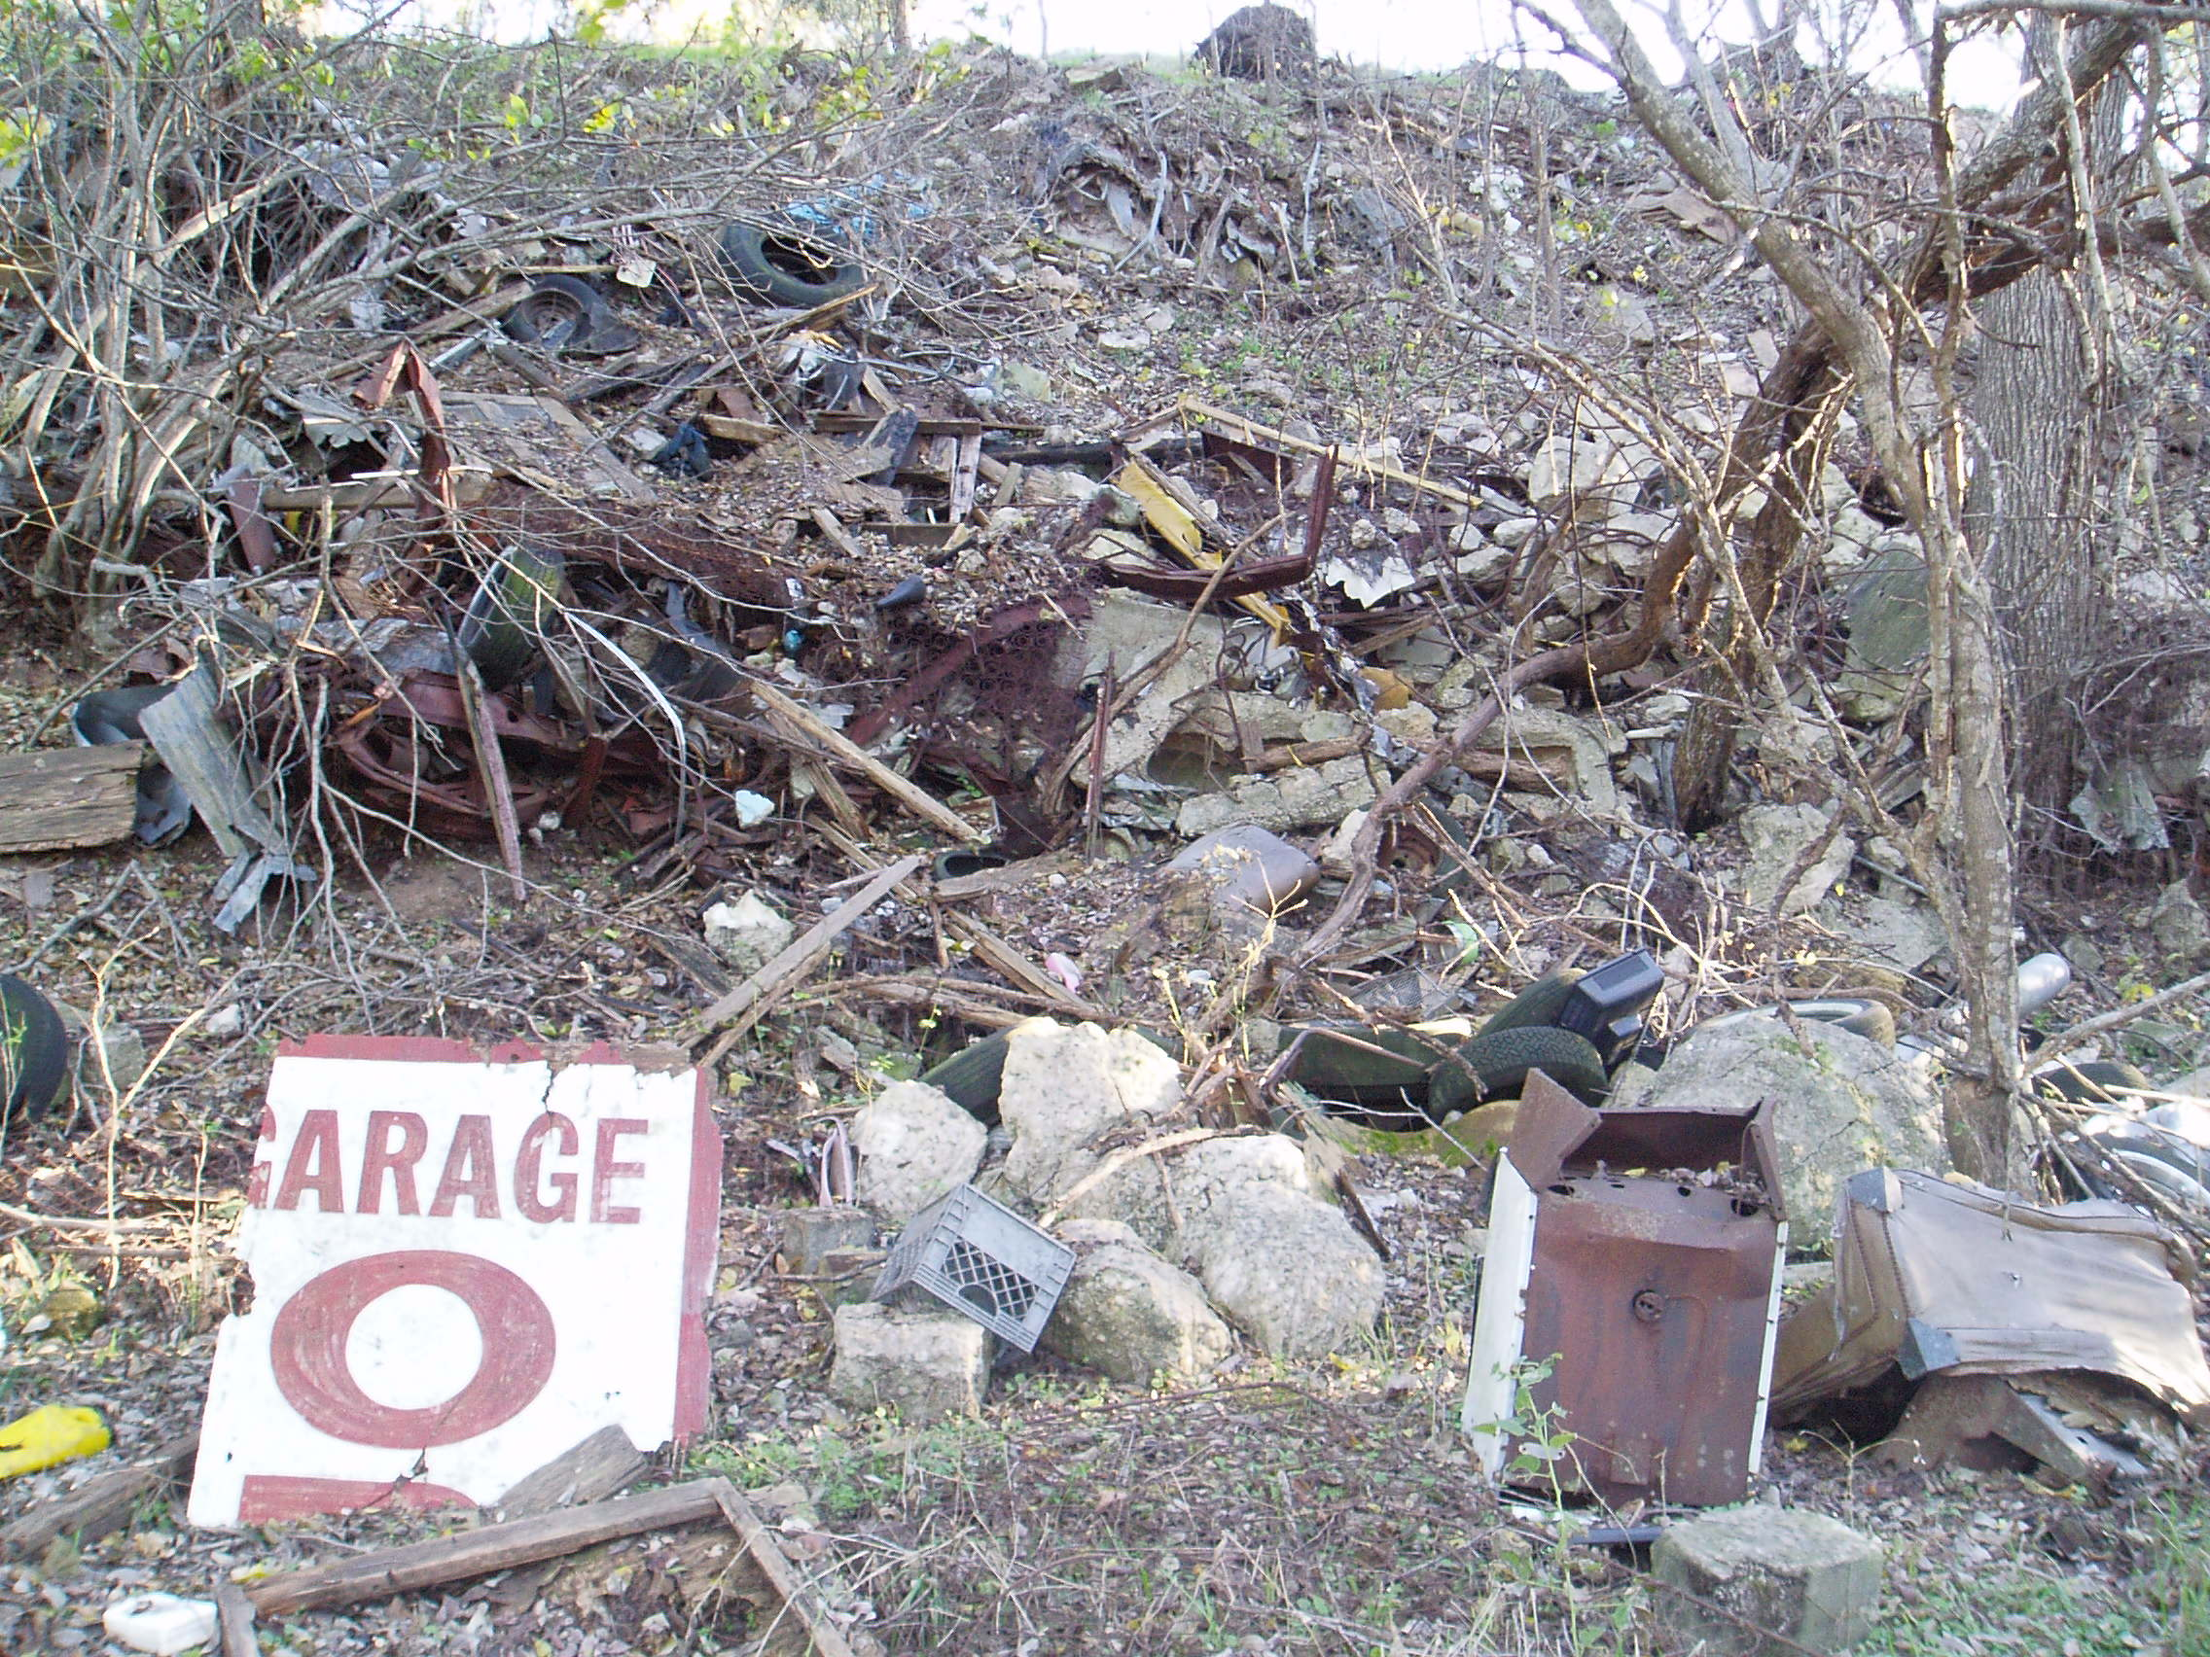
Examples of Brownfields
Notes:
Illegal dump sites, abandoned industrial or can be medical facility, or an abandoned school

Slide 9
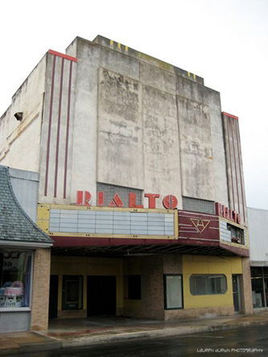
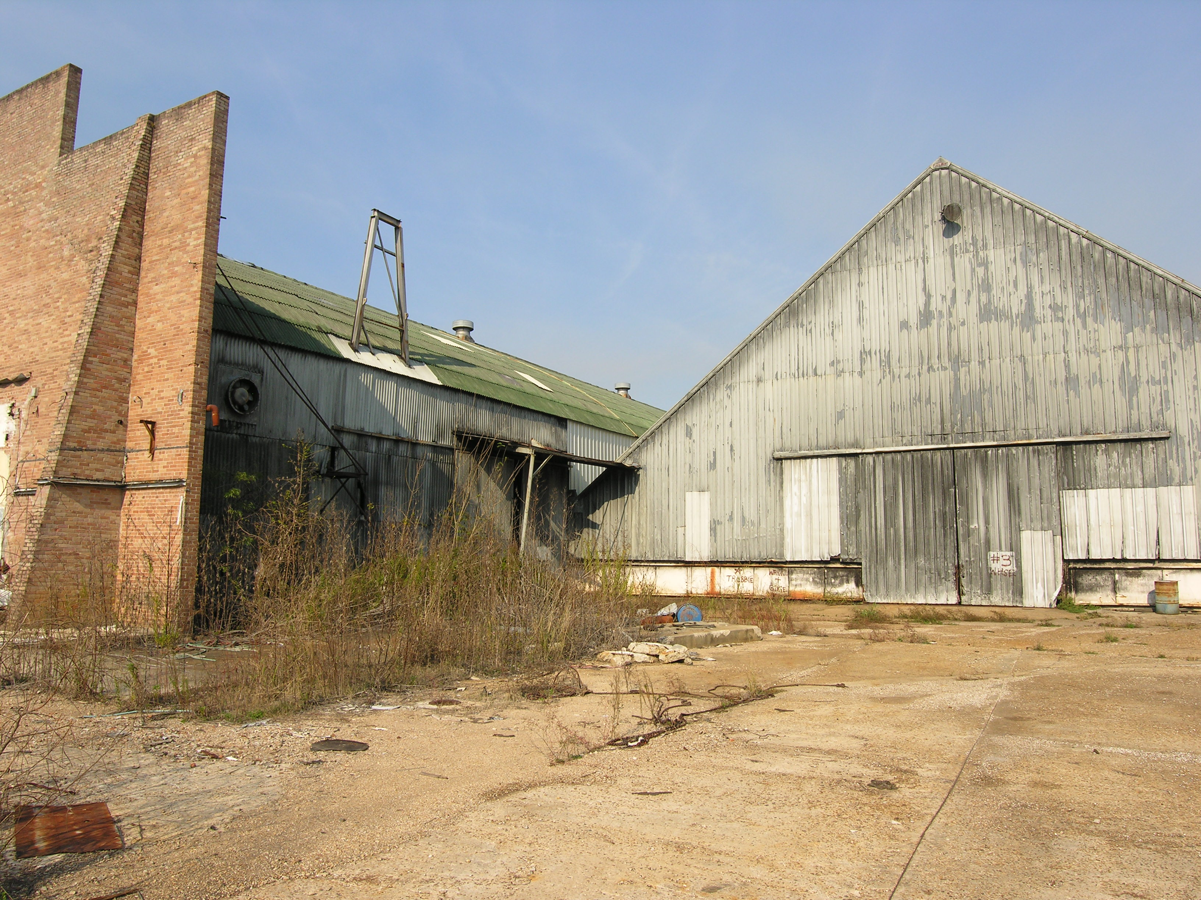
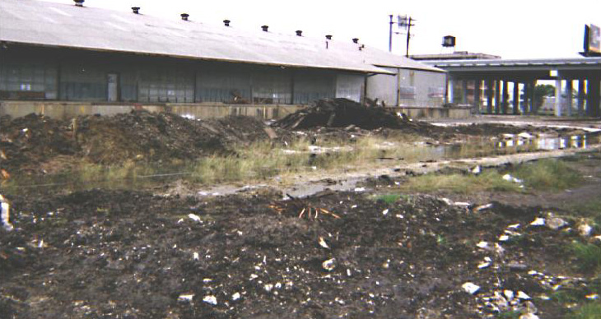
Brownfields Examples
Notes:
Manufacturing/warehouse- keeping in mind the possible presence of hazardous substances

Slide 10

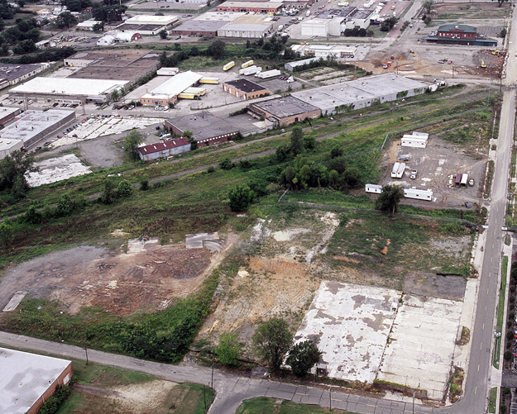

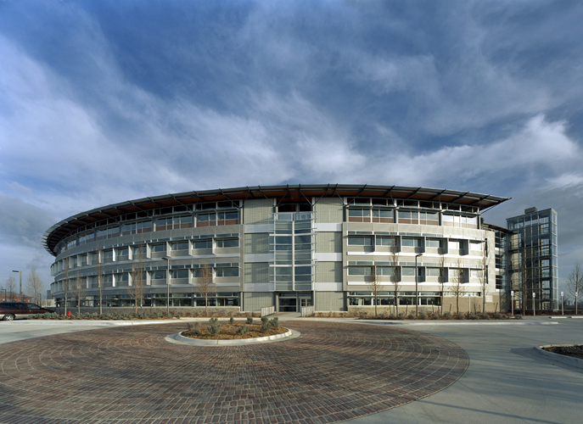
Brownfields Site in Arkansas
Former Trucking & Railroad Operations
Heifer International
Little Rock, AR
Notes:
Heifer International the HQ for World Huger Organization-
Target Area: Former Downtown UP railyard and trucking site
Received a TBA in FY 2003
Amount: $115,000 TBA
For: Phase 2 ESA for contamination at the property, redevelopment and clean-up of railyard material. Revitalization approach for the site was sustainable design and recycling in all aspects, such as the pre-purpose and reuse of available materials found on site. -dubbed Green building of Brownfields.

Slide 11

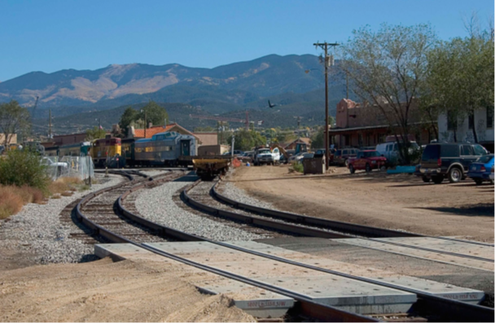

Brownfields Site in New Mexico
Former Railyard Turned Art District
Old Santa Fe Railyard Santa Fe,
New Mexico
Notes:
Brownfields Assessment Pilot Grant Recipient in FY 1996 and Targeted Brownfields Assessment 2001- 50-acre Railyard, Downtown
Assessment grant went to cleanup studies, partnerships, community outreach and removing barriers to redevelopment.
TBA grant went to Characterizing contaminates in the soil ad ground water- After partnership with New Mexico Environment Dept. (NMED) Voluntary Cleanup program- they were able to conduct ESAs- NMED issued their certificate of completion in 2006.

Slide 12


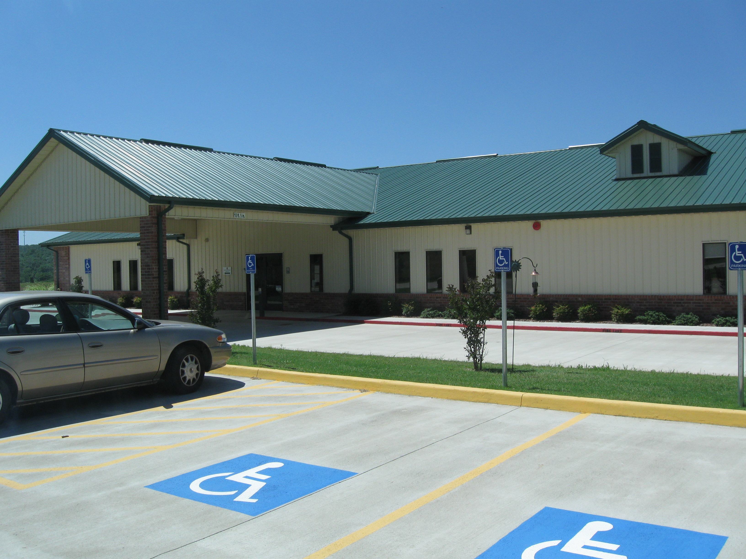
Brownfields States and Tribal
Technical Assistance Program, OK
Inter-Tribal Environmental Council
(ITEC) & Cherokee Nation
Markoma, Oklahoma
Notes:
Received the non-competitive State and Tribal Assistance Grant in 2005
Target Area: Nearly 119-acres consisting of an old High School and surrounding around
Purpose of Funding was used to assess and remediate hazardous substances. Converting the site into a multipurpose Tribal medical, health and fitness center.

Slide 13
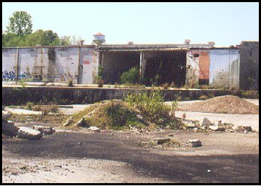
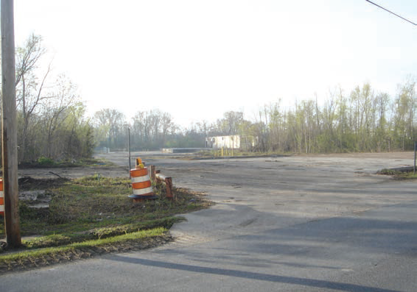
Brownfield Sites in Louisiana
Assessment & Revolving Loan Fund Cleanup
Malter Industries
Gretna, LA
Notes:
Target Area was a 20-year odyssey that finally received its certificate of cleanup from Louisiana Department of environmental Quality (LDEQ) in 2008 and sold to Zatarain’s and McCormick the following year.
Received: EPA Brownfields Assessment Pilot Grant for $200,000 in FY 1997 to conduct ESAs & received a loan from the States RLF granted from EPA to assist in the clean-up of hazardous substances.

Slide 14
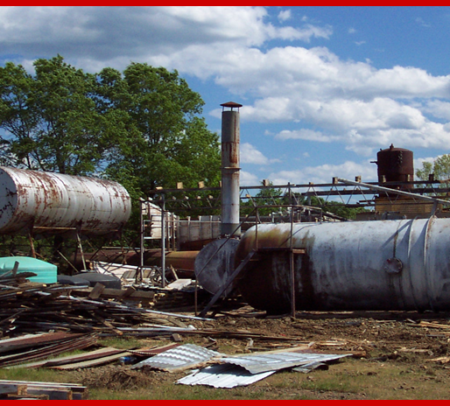
Potential Impacts of Brownfields
Economic
  Decreased property values and city tax revenues
Environmental
  Potential threats to human health and the environment
Social
  Increased urban sprawl and inner-city blight

Slide 15
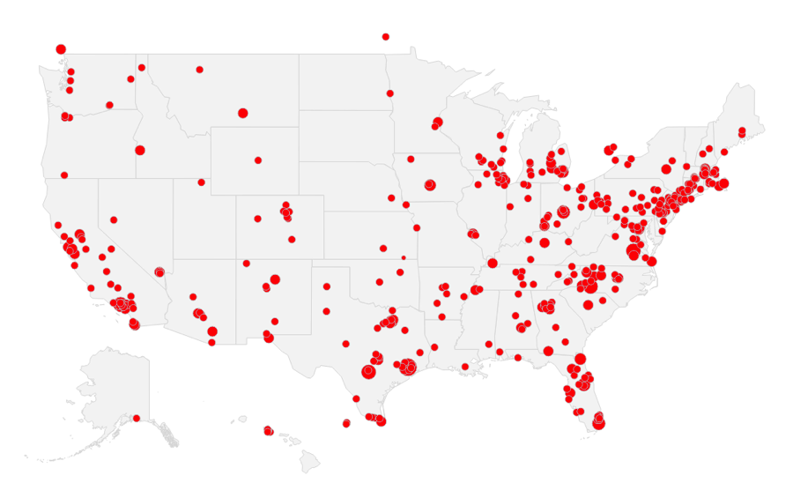
Brownfields occur throughout the United States
There is approximately 450,000 brownfields sites throughout the United States
Notes:
… in both urban and rural areas.
A great place to get started is on EPAs webpage for Brownfields and Land Revitalization in Region 6 will find material for Brownfield grants, stories from around the region and your state Cleanup programs.

Slide 16
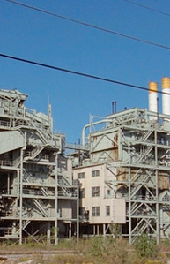
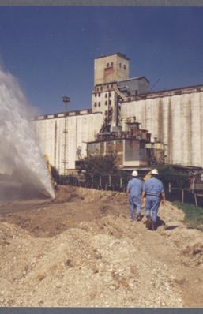
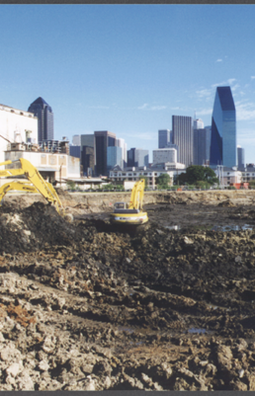
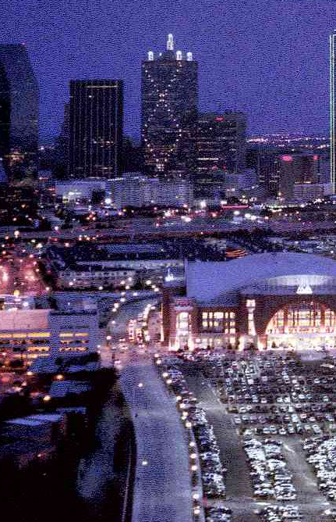
Brownfields Project Process
1. Identify site
2. Assess
3. Clean up
4. Redevelop
Notes:
Process to redevelopment. If no contaminants or hazardous substances are found during assessment, redevelopment can move forward.
*Power plant/silos to Victory Park *largest redevelopment in the Region. > American Airlines center in downtown Dallas, TX
EXPLAIN PROCESS A LITTLE-
When selecting a site, start to rethink its possibilities what nearby resident and local communities will benefit from. Is it green space, residential, industrial, mixed use or commercial. Into step 2, assessment process begins and with much luck with out the need for a phase 2 assessment you can get straight into redevelopment with out clean up.

Slide 17
Elements of Brownfields Revitalization
Determine reuse and vision goals
Identify Brownfield sites
Conduct Environmental Assessments
Prioritize Brownfields
Leverage Funding Resources
Clean Up and Revitalize
Local Stakeholders
RLF and/or Clean up Grants
Assessment grants
Notes:
Local stakeholders are involved throughout all the elements of brownfields revitalization.
the process-
While gathering and maintaining of stakeholders interesting, the process of identifying your brownfields inventory should take precedence along side creating your proposal for obtaining an Assessment grant. By prioritizing that list, work can begin on sites starting with conducting ESAs. The re-leveraging of funds will occur at the potential of contaminates requiring cleanups and EPA has sources available under this years Multipurpose and Clean up grants, to add it this form of revitalization.
Alternating years it is Revolving Loan Fund (RLF)

Slide 18
How does the EPA Brownfields program work?
Part of the program is Grant based and includes funding for State & Tribal Programs
Targeted Brownfields Assessments (TBA)—funding to assist a community on one or more sites though the State/Tribal/EPA program
Technical Assistance to Brownfields (TAB)—a variety of programs to assist tribes/communities, free of charge
Notes:
Grants for communities/organizations along with state and tribal funding.
Technical assistance programs for communities/organization-TAB is the biggest (Scott on TAB later).

Slide 19
Benefits of the Brownfields Program
Revitalize communities
Create jobs and local revenue
Remove blight from the community
Protect the environment
  Projects leveraged $17 per EPA dollar expended
  Leveraged 140,000 jobs nationwide
  Residential property values increase by 5% to 15% when brownfield sites are cleaned up.
Notes:
Creation of employment - According to a survey by the U.S. Conference of Mayors, 187 of 231 cities responded that cleaning up existing brownfields sites could generate as many as 540,000 new jobs if the land were returned to production.
Increased local revenue - Encouraging development on existing, unoccupied sites has the potential not only to rejuvenate local tax revenue, but to spawn additional development of nearby underused properties.
Revitalize urban areas - Because of their locations, brownfields promote the infill and mixed-use development of smart growth
Removal of urban eyesores – Perception of contamination; Brownfields cleanup removes signs of decay
Protection of existing greenspaces – creating incentives to attract development on existing sites curbs the urge to develop pristine areas
Improved cmty health – Curbs illegal dumping; cleanup removes potential public health threat of contamination

Slide 20

Brownfields Assistance and Funding Opportunities
Assessment Grants
Clean Up Grants
Revolving Loan Funds
State Response Programs
Technical Brownfields Assistance
Job Training Grants
Multipurpose Grant
Notes:
More on grants info with Denise and Paul day two.

Slide 21
Brownfields Assistance Opportunities – Eligible Applicants
Regional Councils of Government
Cities
Redevelopment Agencies
States
Non-profit organizations
Local Governments
Tribes

Slide 22
Brownfields Assistance – Potential Contaminants
Mine scarred lands
Petroleum Products
Contaminants
Illegal drug labs
Pollutants
Lead based paint
Asbestos
Hazardous Substances

Slide 23
Not Eligible for Brownfields Assistance – Applicants and Contaminants
Applicants
Potentially Liable Parties
Private owners/developers
Contaminants
Sites listed on National Priorities List
Sites subject to CERCLA order
Sites subject to the control of the federal government

Slide 24
Liability Protection
IMPORTANT: YOU MUST CONDUCT A PHASE I PRIOR TO THE ACQUISION OF PROPERTY
EXEMPTION
Publicly owned sites acquired prior to January 11, 2002 can apply for assessment and remediation (RLF and cleanup) grants as long as the entity is not responsible for the contamination.
Notes:
Failure to conduct a Phase I (All Appropriate Inquiry) could result in ownership of liability of contaminants.
Conducting a Phase I will determine All Appropriate Inquiries – obtaining liability protection under CERCLA. (Jake Liability presentation)

Slide 25
All Appropriate Inquiry = Phase I Environmental Site Assessment
All Appropriate Inquiry (AAI) or Phase I environmental site assessment (ESA) is the process of evaluating a property for potential environmental contamination and assessing potential liability for any contamination present at the property or ASTM Standard E1527-13.

Slide 26
State Brownfields Programs
Are the technical decision makers
Provide State Environmental Liability Protection
Are a key partner with the EPA
Notes:
Partners to mention; TCEQ & RRC (Texas Railroad Commission) – Petroleum regulator, LDEQ, ODEQ & OCC (Oklahoma Corporation Commission) – Petroleum regulator, ADEQ, and NMED.

Slide 27
Targeted Brownfields Assessments and State and Tribal Response Program
Targeted Brownfields Assessments (TBA)
  Provided by EPA or State, free of charge
    Area-wide inventories
    Phase I – Research
    Phase II – Sampling
    Phase III – Cleanup Planning
  Available year-round, performed by service contractors and managed by EPA or State
State and Tribal Response Program
  Funding is non-competitive
  Awarded on an annual basis
  Can also be used for limited site assessments or cleanups at brownfield sites
  Purchase environmental insurance
  Develop other insurance mechanisms for cleanup activities

Slide 28
Brownfield
Resources & Guides
Links
Targeted Brownfields Assessments (TBA)
State and Tribal Response Program Grants
EPA Region 6 Brownfields Program,
Targeted Brownfields Assessments Lead
  Roxanne Welch
  Welch.Roxanne@epa.gov
  214-665-2235
EPA Region 6 Brownfields Program
State/Tribal Coordinator for 128(a) Grant
Elizabeth Reyes
Reyes.Elizabeth@epa.gov
214-665-3163

Slide 29

Brownfields Technical Assistance
Kansas State University – Technical Assistance for Brownfields (TAB)
TAB provides technical assistance to communities and other stakeholders on brownfields issues to increase the community’s understanding and involvement in brownfields cleanup and revitalization and help to move brownfields sites toward cleanup and reuse.
Project selections are contingent on available funding and management approval. KSU-TAB assistance is provided as a service, rather than a funding opportunity.
The basic types of activities provided include:
Advising on grant proposal preparation
Direct technical mentoring
Technical assistance workshops
Information sharing and education

Slide 30
TAB
Resources & Guides
Links
EPA KSU-TAB information
Kansas State University TAB Community Fact Sheet
TAB Program Webpage
TAB Coordinator
  Scott Nightingale
  scottnight@ksu.edu
  (785) 532-6028

Slide 31
Current Brownfields Grant Schedule
Guidelines were posted in late August on grants.gov
Proposals due 28 October 2020
Anticipated announcement May 2021
Next anticipated grant solicitation October 2021

Slide 32
Recent Changes
One budget!!
  Includes both hazardous and petroleum
More Federal Forms are part of application
  Applications for Federal Assistance (SF-424)
  Budget information for Non-Construction Programs (SF-424A)
  Pre-award Compliance Review Report (EPA Form 4700-4)
  EPA Key Contacts (Form 5700-54)
  Narrative Information Sheet, the Narrative, and required attachments

Slide 33
Opportunity Zones
If a site is in an OZ
Or, site redevelopment benefits an OZ
  Discuss in proposal!

Slide 34
Assessment Grant
Up to $300,000
Up to $600,000
  Coalition of at least three eligible entities
Up to 50% of funds can be used for planning
Three-year project period
Notes:
3 ways the assessment grant can be awarded
Community-wide Assessment Grants
Up to $300,000 to assess
Site-specific Assessment Grants
Used on one site only
Up to $200,000 to assess
Can request a waiver up to $350,000
Assessment Coalition Grants (COAG)
Is for three or more eligible entities
One grant proposal submitted under the name of one of the lead coalition members.
Must assess a minimum of five sites regardless of funding request
Up to $600,000
- Can be used to assess hazardous and petroleum

Slide 35
Assessment Grant Details
Developing inventories and prioritizing sites
Conducting Community Involvement activities
Conducting Environmental Site Assessments
Developing Cleanup and Reuse Plans
Developing Area Revitalization Plans
Notes:
Developing an inventory of Brownfield sites, conducting community involvement activities, Phase 1 & 2 Environmental Site Assessments, Clean up reuse planning and developing area wide revitalization plans

Slide 36
Cleanup Grant
Up to $500,000
20% cost share
  May request a waiver
5% administrative cost
One or more sites
Three-year project period
Notes:
Clean up grants provide funding to eligible entities to carry out clean up activities
Up to $500,000 to address 1 or more BF
Applicant is sole owner of the sites prior to application
3-year performance

Slide 37
Cleanup Grant Details
One or more applicant owned site(s)
A Phase II ESA must be completed
An Analysis of Brownfields Cleanup Alternatives (ABCA) must be attached
Conducting Community Involvement activities
Notes:
Conducting community involvement activities
Applicant has completed a Phase 2 ESA
Have one or more applicant owned sites with clean-up potential.
Submit one Cleanup Grant proposal each competition cycle, along side with Analysis of Brownfields Cleanup Alternatives (ABCA) for each site.

Slide 38
Multipurpose Grant
Up to $800,000
$40,000 cost share
  No waiver
5% administrative cost
Combination of Assessment and Cleanup
Five-year project period
Notes:
Provide a range of eligible assessment and cleanup activities
Up to $800,000 to conduct one Phase II environmental site assessment and one cleanup and overall plan for revitalization.
Five-year performance period

Slide 39
Multipurpose Grant Details
Developing inventories and prioritizing sites
Conducting Community Involvement activities
Conducting Environmental Site Assessments
Developing Cleanup and Reuse Plans
Conducting Cleanup Activities (owned sites)
Notes:
Applicant should have a capacity to do the following:
Develop inventories and prioritize sites
Conduct community involvement activities
Conduct environmental site assessments
Develop cleanup and reuse plans
Conduct cleanup activities on owned sites

Slide 40
Revolving Loan Fund Grant
Provides up to $1,000,000
Can loan to public or private developers
Grantee determines loan terms
20% cost share
Five-year performance period
Notes:
Can provided funds up to a million dollars
can be loan to public or private developers
Grantee determines loan terms
5-year performance

Slide 41
Revolving Loan Fund Grant Details
Nonprofits, LLCs and Non-profit community development entities are eligible
Up to 5% of grant awards on administrative costs
Eligible activities include cleanup, loan program implementation and confirmatory sampling only
Can apply as an eligible individual entity or as an RLF Coalition comprised of two or more entities.
Notes:
Nonprofits, LLCs and Non profit community development entities are eligible
Up to 5% of grant awards is used on administrative costs
Eligible activities include cleanup, loan program implementation and confirmatory sampling only
Can apply as an eligible individual entity or as an RLF Coalition comprised of two or more entities.

Slide 42

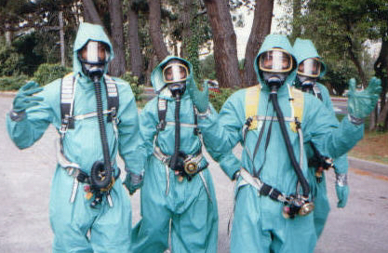
Environmental Workforce &
Job Training Grant (EWDJT)
Conducts environmental training, allowing applicants to tailor the curriculum of their programs
OSHA 29 CFR 1910.120 40-hour HAZWOPER is the only required training.
Provides up to $200,000
Three-year Performance
period
Up to 5% of grant awards on administrative costs
Notes:
the Environmental Workforce & Job Training Grant (EWDJT)…
Allow nonprofits, local gov, and other organization to recruit and train residents affected by the presence of a near BF.
The OSHA 40 Hour HAZWOPER is the only required training
Grant helps to conduct environmental training and tailoring through a curriculum program-
Funding can up to $200,000
with a 3-year performance period

Slide 43
Brownfield
Resources & Guides
Links
Types of Grant Funding
Solicitations for Brownfield Grants
EPA Brownfields 2019 Federal Programs Guide
EPA Region 6 Brownfields Program,
Region 6 National Competition Co-Leads.
Denise Williams - Assessments
  Williams.denise@epa.gov
  214-665-9749
  Paul Johnson - Cleanups
  Johnson.paul@epa.gov
  214-665-2246
  Camisha Scott – RLF & Job Training Grant
  Scott.camisha@epa.gov
  214-665-6755

Slide 44
Newest BF Team Members
Emily Jimenez
Jimenez.Emily@epa.gov
214-665-2176
Michael Kennedy
Kennedy.Michael@epa.gov
214-665-7125

Slide 45

Save the date, mark your calendar, and plan to attend!
Oklahoma City September 27-30, 2021

Slide 46
References
EPA’s National Brownfields Website:
https://www.epa.gov/brownfields
EPA’s Region 6 Brownfields Website:
https://www.epa.gov/brownfields/brownfields-and-land-revitalization-texas-new-mexico-oklahoma-arkansas-and-louisiana
EPA Brownfield 101 Factsheets
https://www.epa.gov/brownfields/understanding-brownfields

Slide 47
Currently our FY21grant competitions are underway
.
  We anticipate our annual assessment and cleanup grant competitions will be announced in May.
  We are finalizing the FY21 Environmental Workforce Development and Job Training program now, anticipated announcement in March.
  We are re-competing existing technical assistance providers who support many communities to help them address their brownfields issues and anticipate that announcement in the spring.

