Slide 1
Leadership Central Texas 2022
Graduation Ceremony
Notes:
NOTE:
To change the image on this slide, select the picture and delete it. Then click the Pictures icon in the placeholder to insert your own image.

Slide 2
Leadership Central Texas 2022
Leadership Central Texas is offered by the Development District of Central Texas to citizens with an interest in leadership who live or work within the seven county-region served by the Central Texas Council of Governments, which includes Bell, Coryell, Hamilton, Lampasas, Milam, Mills, and San Saba counties.

Slide 3
Leadership Central Texas 2022
The purpose of Leadership Central Texas is to identify and develop regional leaders, to promote awareness of regional and state leadership opportunities and to create a network of relationships among leaders to insure the growth and future well-being of our Central Texas Region.

Slide 4
Leadership Central Texas 2022
This year’s program covered the following topics:
Federal, State, and Local Government and CTCOG Services
Regional Infrastructure and Social Services
Leadership Opportunities
Entrepreneurship, Economic & Business Development

Slide 5
Guest Presenters and Partners
Texas House Rep. Brad Buckley, District 54
Texas House Rep. Hugh Shine, District 55
City Manager Brynn Myers, City of Temple
Bell County Judge David Blackburn
Jason Deckman, City Planner, City of Temple
Casey Simpson, Oncor Area Manager
Brent Connett, Deputy Director, Appointments Division, Office of the Governor
Jarvis Brewer, Small Business Advocate, Office of the Governor
Charley Ayers, Workforce Solutions of Central Texas
Jason Ehler, Business Advisor, McLennan Small Business Development Corp.
Michael N’dolo, Director of Economic Development, MRB Group
Dirk Aaron, General Manager, Clearwater Underground Water Conservation District
Carmen Lim, Director of Housing Division, CTCOG
George Losoya, Director of Area Agency on Aging, CTCOG
Johnnie Wardell, Executive Director, Central Counties Services
Anthony Martinez, Director, American Veterans Mission
Colonel Chad Foster, Commander, USAG, Ft. Hood
Keith Sledd, Executive Director, Heart of Texas Defense Alliance
Bob Harrell, Coryell County Emergency Management Coordinator
Brittney Eiklor, Outreach Coordinator, Child Advocacy Center of Central Texas
Veshell Greene, Vice President of Resource Development, United Way of Central Texas
Ebony Jackson, Director, Bell County Indigent Healthcare Program
Dr. Marty McMahone, PhD., Professor of Business, University of Mary Hardin-Baylor
Sanfrená A. Britt , PhD., Director, UCARE, Texas A&M University-Central Texas
James McGill, KTMPO Planning Manager
Jim Reed, AICP, Executive Director, CTCOG
Uryan Nelson, Director, CTCOG Planning & Regional Services
Jesse Hennage, Assistant Director, CTCOG Planning/Public Safety
Dominic Elizondo, Economic Development Planner, CTCOG
Darrell Burtner, Director, Urban Operations, Hill Country Transit District
James Wickham, Mobility Manager, Hill Country Transit District

Slide 6
The Graduates of
Leadership Central Texas 2022
Notes:
NOTE:
To change the image on this slide, select the picture and delete it. Then click the Pictures icon in the placeholder to insert your own image.

Slide 7
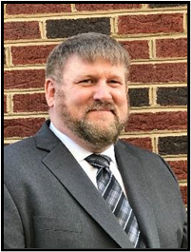
“By participating in the 2022 Leadership Central Texas program, I have access to multiple pathways that will help me share forward-thinking solutions and innovative ideas. My goal is to be a public service role model for my community and create strategic opportunities for everyone in Central Texas.”
Camron Cochran, Ph.D.
U.S Army, Retired
Guest Teacher
Killeen ISD, Copperas Cove ISD
Notes:
NOTE:
To change the image on this slide, select the picture and delete it. Then click the Pictures icon in the placeholder to insert your own image.

Slide 8
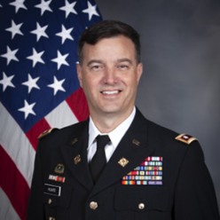
“The Central Texas Council of Government Leadership Academy provided valuable information for citizens to be “in the arena” of our communities in order to make it a better place to live, thrive and develop. As a local resident for over ten years, I was unaware of the many services that are offered to assist local residents and now fully believe that I can connect these capabilities to people I know may be in need.”
LTC Dean A. Huard
Brigade Executive Officer
407th AFSB, Ft. Hood, Texas
Notes:
NOTE:
To change the image on this slide, select the picture and delete it. Then click the Pictures icon in the placeholder to insert your own image.

Slide 9
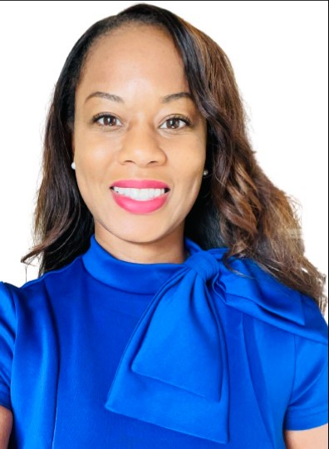
“Inspired doesn’t do justice to describing my experience with Leadership Central Texas, ignited is more of the term. The past three sessions equipped me with the necessary resources to confidently carry with me in my leadership journey throughout Central Texas. Understanding the importance of the roles and benefits of each organization has ignited me to continue to pursue my Doctor of Public Health and a higher-level position within my region so that I can also be a greater resource to our future leaders.”
Erin Hughley
Health Disparities Program Coordinator
Bell County Public Health District
Notes:
NOTE:
To change the image on this slide, select the picture and delete it. Then click the Pictures icon in the placeholder to insert your own image.

Slide 10
“I was impressed with the number of guest presenters during each program day. Since I am new to Texas, it was incredibly helpful for me to understand the basic infrastructure of Central Texas and ask questions. Having the opportunity to speak with subject matter experts is priceless and often difficult to do in terms of normal business interactions.“
Jamie LaDuke
Executive Director
Hamilton EDC
Notes:
NOTE:
To change the image on this slide, select the picture and delete it. Then click the Pictures icon in the placeholder to insert your own image.

Slide 11
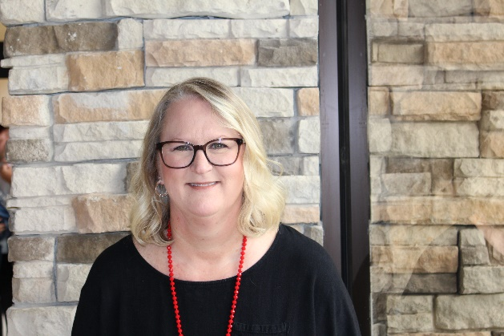
“One of the many things I noticed about each speaker is that the spoke with confidence and passion about their organization. I have decided to go back to school and pursue a degree in Organizational Leadership so that I too will have the confidence in my abilities to lead while I continue to support not only those within our organization but also those that I select to be a part of. It is my mission to serve as a leader at work and in my community by supporting, inspiring and encouraging others so that they too may achieve their goals and make a difference.
Dawn Orange
Membership and Operations
Belton Area Chamber of Commerce
Notes:
NOTE:
To change the image on this slide, select the picture and delete it. Then click the Pictures icon in the placeholder to insert your own image.

Slide 12
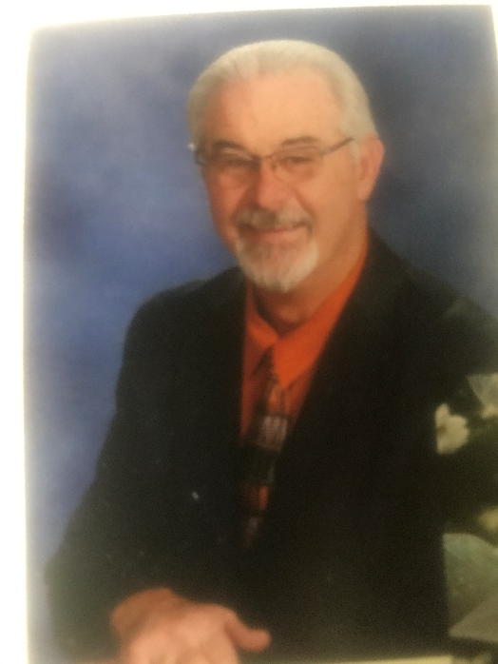
“I have learned that there is much to learn. I appreciate all of those who have given of their time to come to our meetings and share their advice with us. Thank you to your team, for your time and efforts.”
David Richardson
City Councilmember
City of Kempner
Notes:
NOTE:
To change the image on this slide, select the picture and delete it. Then click the Pictures icon in the placeholder to insert your own image.

Slide 13
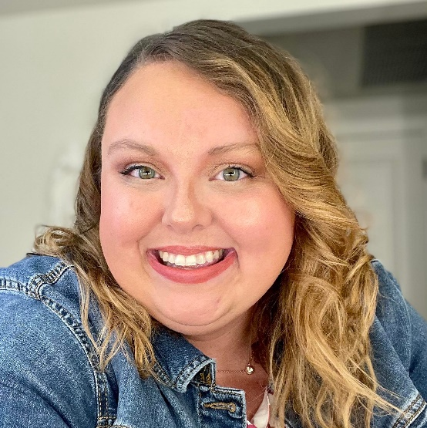
“Leadership Central Texas has not only reinforced this career choice and passion for me but has deepened my understanding of what it means to lead and encourage my peers, team and community. Thank you Leadership Central Texas for affording me the opportunity to connect with other professionals who have devoted their life for the same purpose and meaning. The discussions and networking that came from this course are irreplaceable!”
Jennifer Shidler
Community Outreach Coordinator
City of Nolanville
Notes:
NOTE:
To change the image on this slide, select the picture and delete it. Then click the Pictures icon in the placeholder to insert your own image.

Slide 14
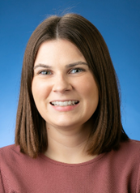
“We are a small area with not many people but the people that have taken on the role as a leader here and represent the people do so with growing knowledge, an understanding of the needs of people, and a passion for what they do daily. Moving forward as a leader in the Planning Division of the COG I hope to continue to provide connections for citizens with the resources and knowledge that can make them more informed. My organization is a great resource for cities and counties, but we will continue to strengthen our efforts in the general public.”
Connie Quinto
Assistant Director
Planning Division
CTCOG
Notes:
NOTE:
To change the image on this slide, select the picture and delete it. Then click the Pictures icon in the placeholder to insert your own image.

Slide 15
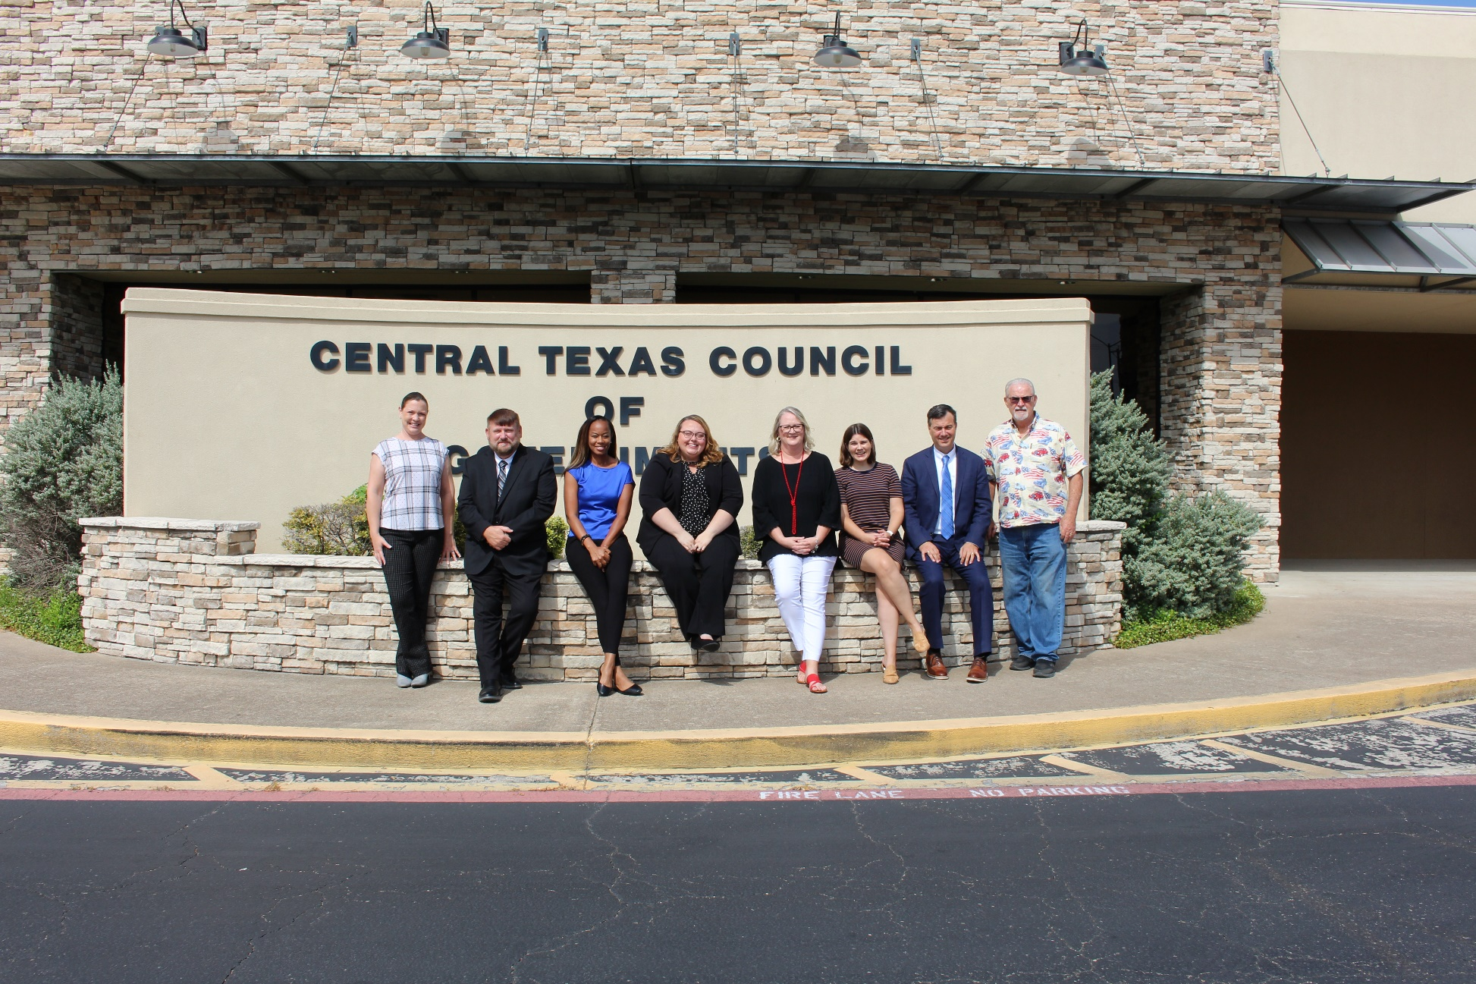

Slide 16
Participants Contact Information
Camron Cochran, Ph.D, U.S. Air Force, Retired, KISD, CCISD
LTC Dean Huard, Brigade Executive Officer 407th AFSB, Fort Hood
Erin Hughley, Health Disparities Program Coordinator, Bell County Public Health District
Jamie LaDuke, Executive Director, Hamilton EDC
Dawn Orange, Membership and Operations, Belton Area Chamber of Commerce
David Richardson, Councilmember, City of Kempner
Jennifer Shidler, Community Outreach Coordinator, City of Nolanville
Connie Quinto, Assistant Director, Planning and Regional Services Division, CTCOG
cochranc05@yahoo.com
deanhuard@me.com
ehughley@bellcountyhealth.org
edc@hamiltontx.com
dawn@beltonchamber.com
utdrichardson@gmail.com
jshidler@nolanvilletx.gov
connie.quinto@ctcog.org

Slide 17
Leadership Central Texas 2022

